Slide 1
Weather Trend Forecasting
Our Mission
By making industry-leading tools and education available to individuals from all backgrounds, we level the playing field for future PM leaders. This is the PM Accelerator motto, as we grant aspiring and experienced PMs what they need most – Access. We introduce you to industry leaders, surround you with the right PM ecosystem, and discover the new world of AI product management skills.

Slide 2
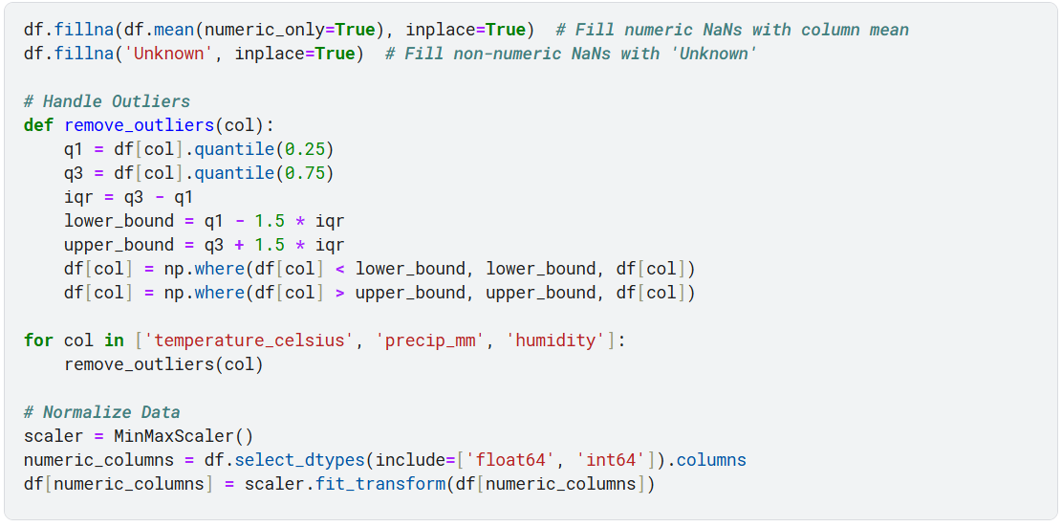
Data Cleaning & Preprocessing

Slide 3
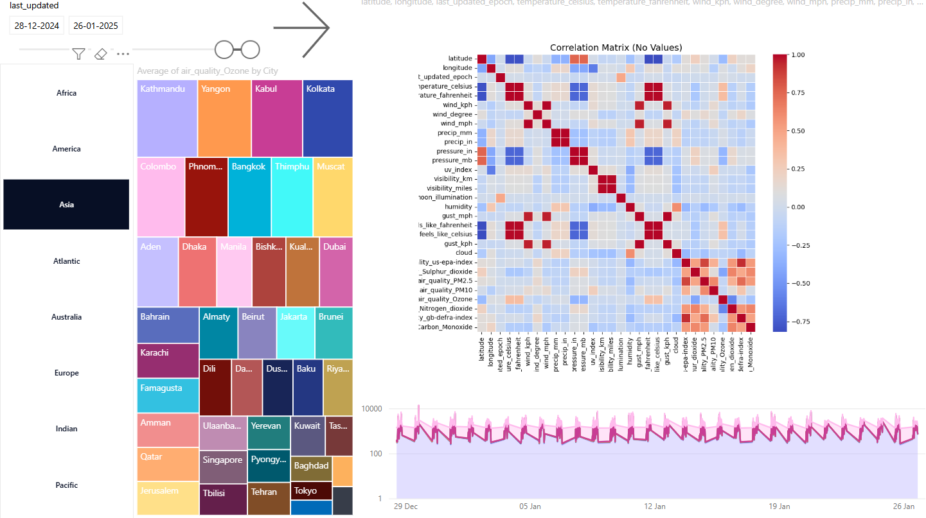
Exploratory Data Analysis (EDA)

Slide 4
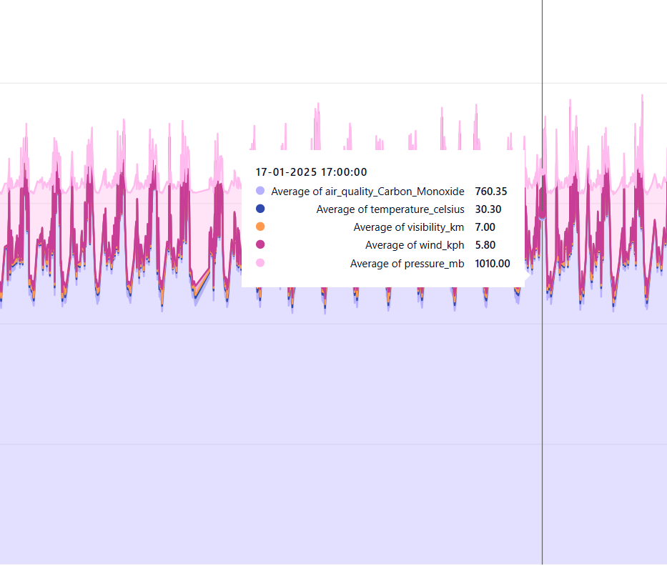
Exploratory Data Analysis (EDA)
I have performed exploratory data using python code as well as Power BI.
We can clearly see by looking at the area plots that all the values are highly corelated, but the same may not be depicted by the heatmap, clearly showing that heat maps may not always be the best indicators for such use cases, considering that some values are very small and some are very large.

Slide 5
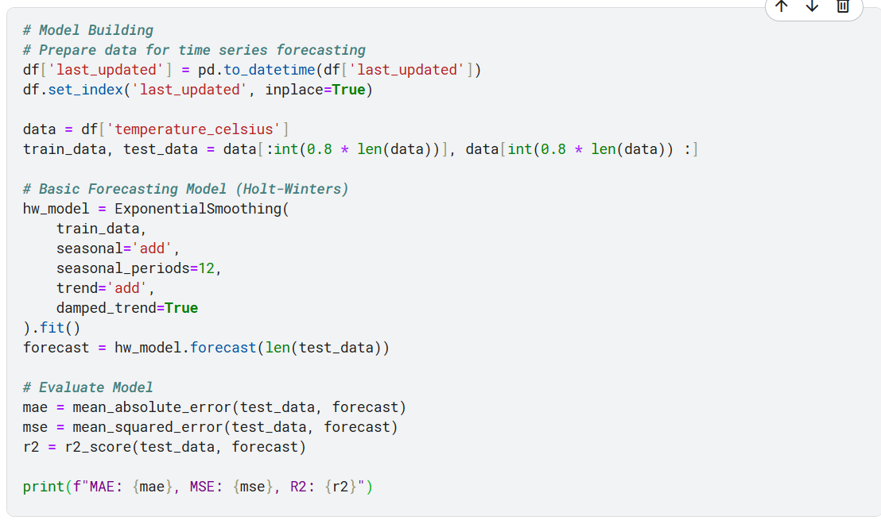
Model Building

Slide 6
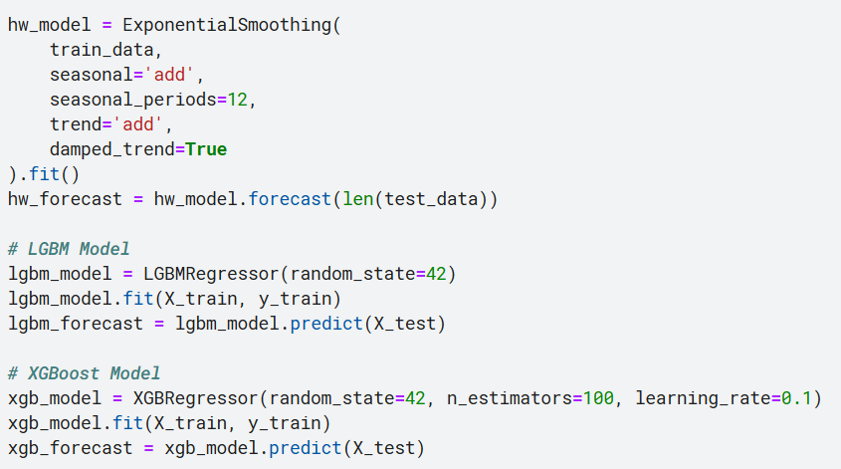
Advanced analysis – Multiple models

Slide 7
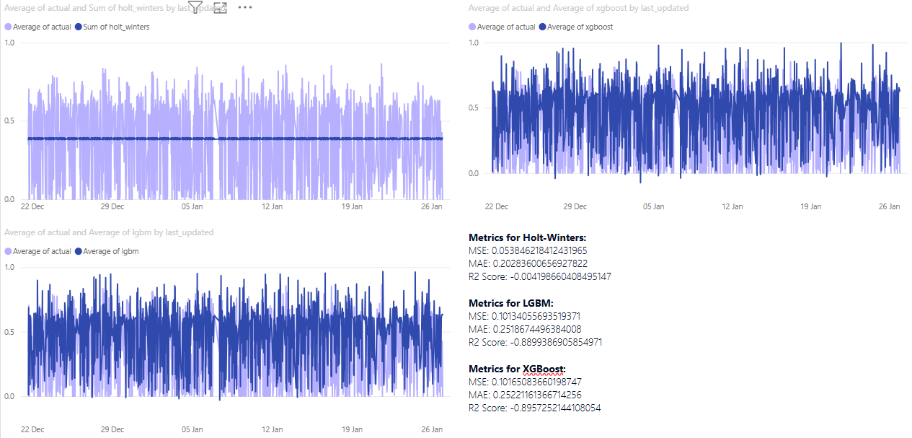
Advanced analysis – Multiple models
I have used 3 models to see which model works the best and by looking at the below results we can see that LGBM has the best overall performance.

Slide 8
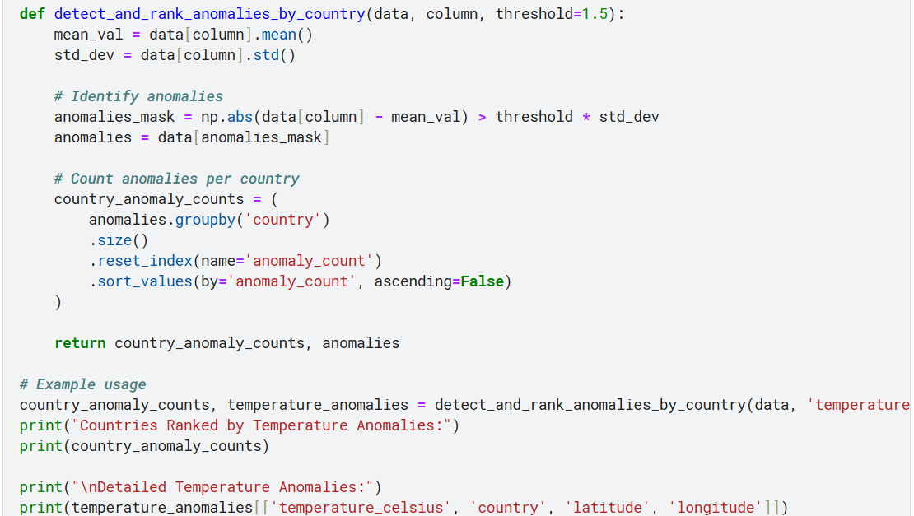
Unique Analyses – Anomalies

Slide 9
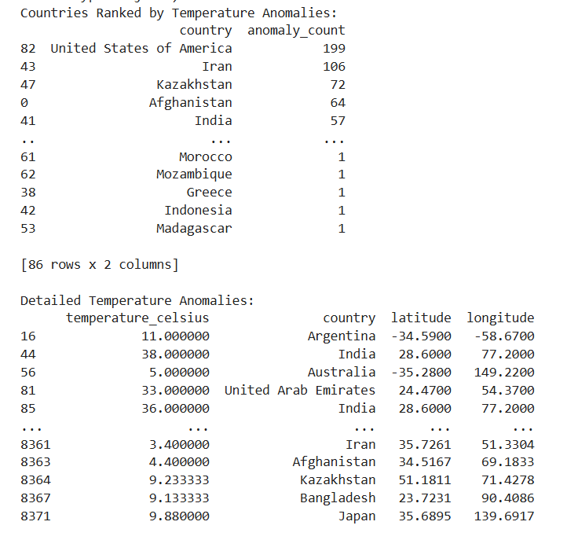
Advanced EDA – Anomalies
We can use this analysis if we are forecasting one country in particular
For example we can see that USA is a very high anomaly count, this means that if we try to make predictions for the US then its best to add more randomness to its predictions.
The exact opposite goes for Madagascar where there’s only 1 Anomaly.

Slide 10
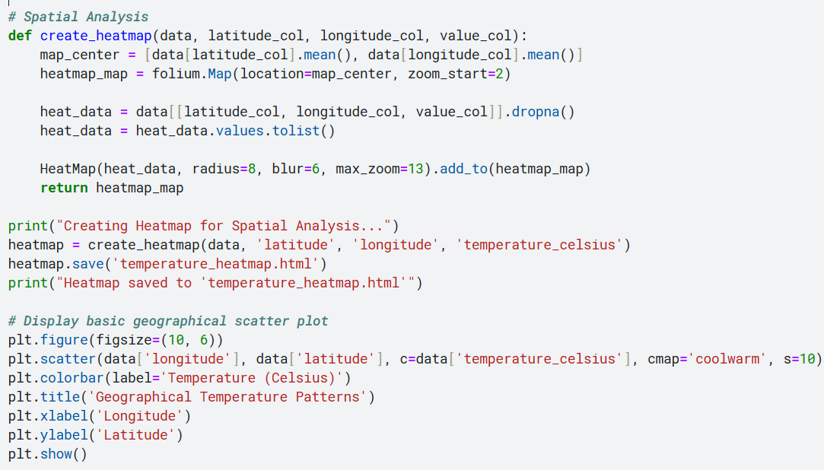
Spatial Analysis

Slide 11
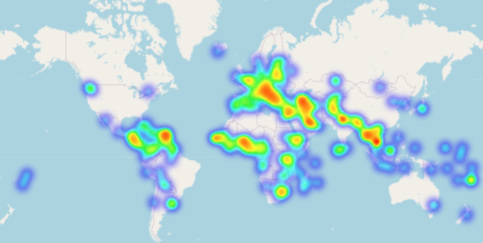
Spatial Analysis

Slide 12
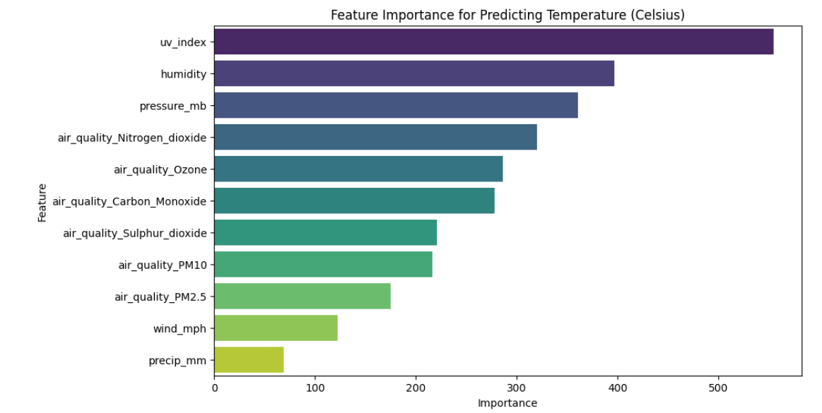
Feature Importance
We can use this information to get more insight on what the model believes is the most important feature.

Slide 13
thank you
Morvin Prajapati
tactmorvinap259@gmail.com

